Slide 1
Hard Shoulder Running – Lessons Learned During Design, Construction, and Implementation
Brian Toombs, PE

Slide 2
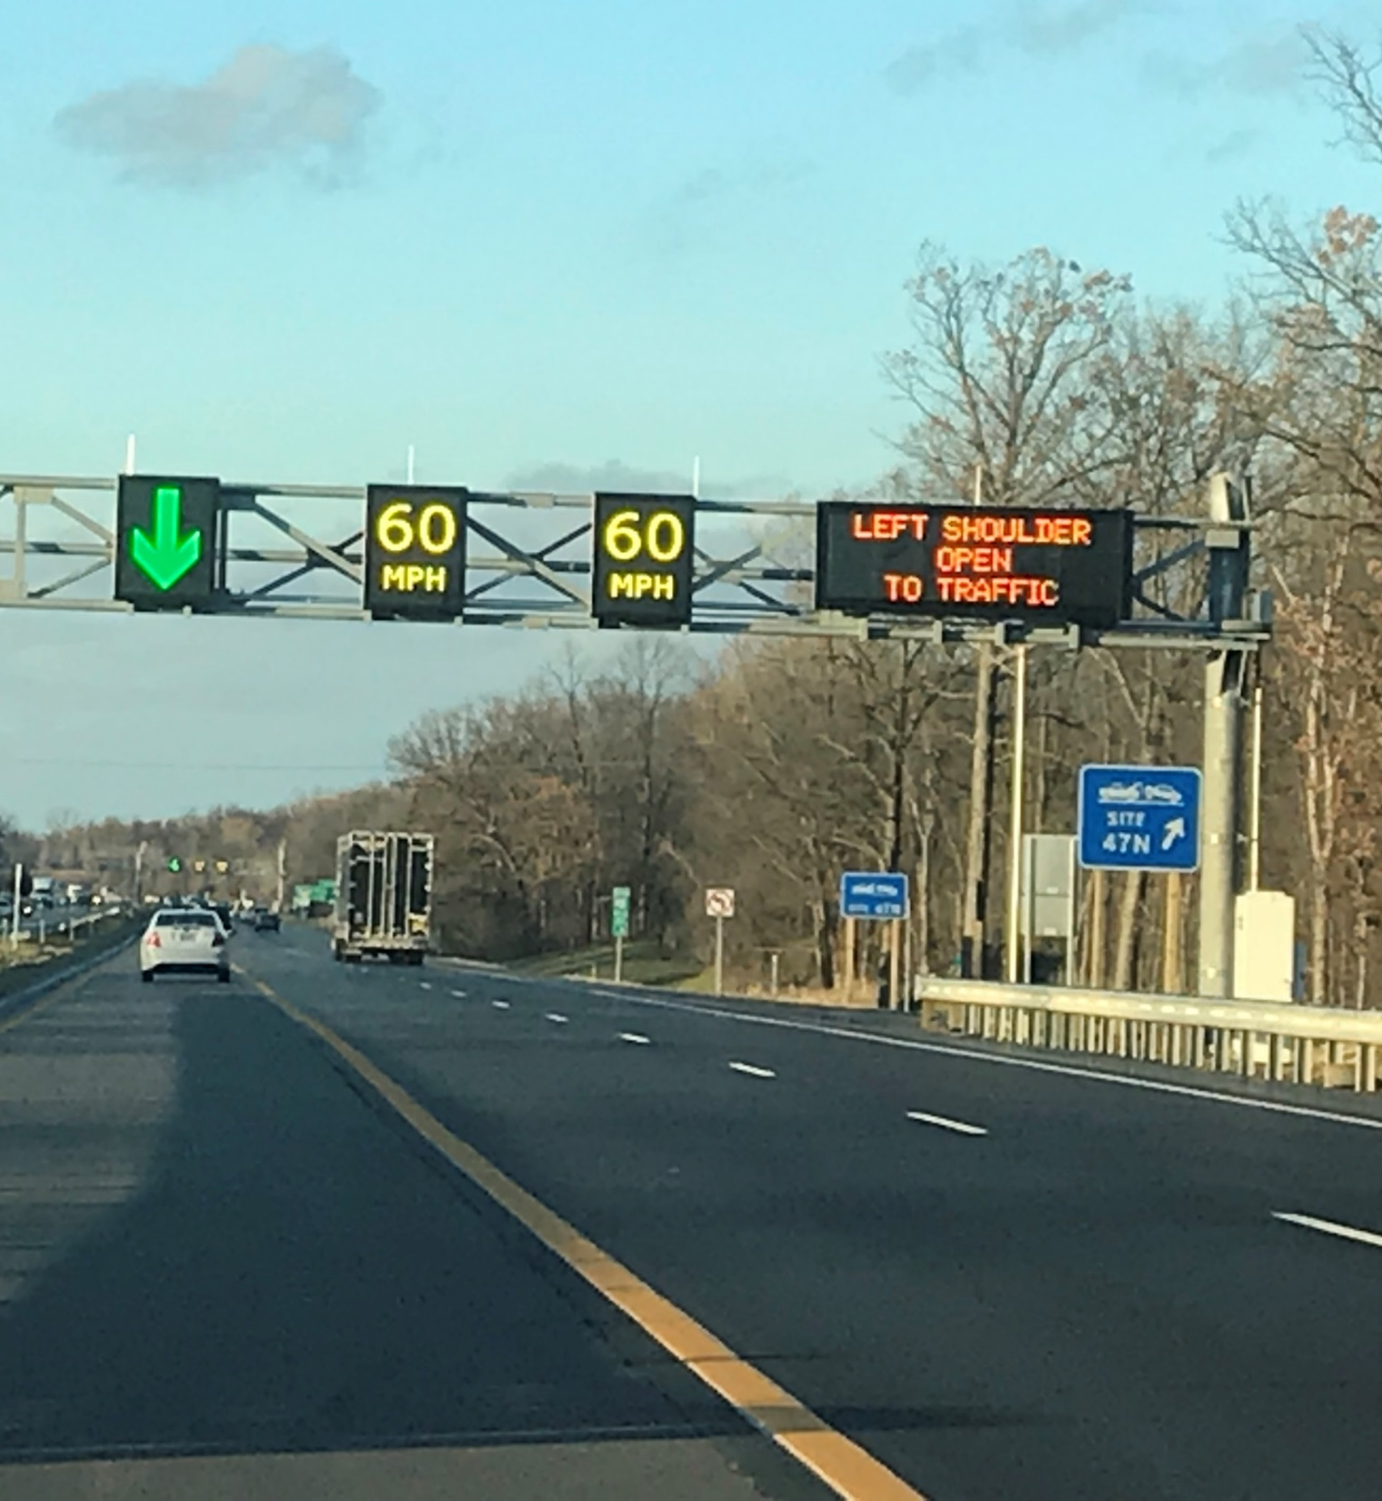
Agenda
What is HSR?
Where is HSR Implemented?
Analysis Considerations
Traffic
Safety
Cost Considerations
Design Considerations
Implementation
Operations
Screening Process

Slide 3
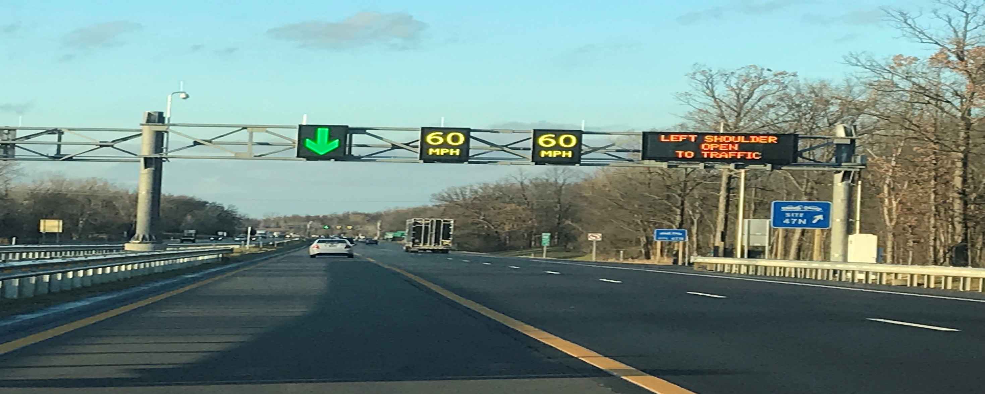
What is HSR?

Slide 4
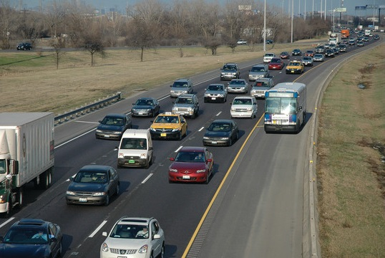
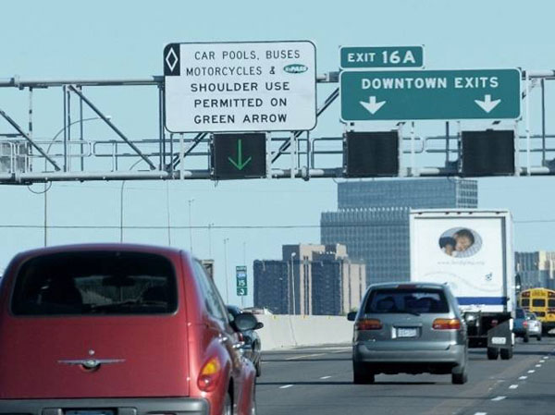
What is HSR?
The use of the left or right safety shoulder of an existing roadway for travel during certain hours of the day
Preserves shoulder as shoulder during most hours of the day; not a permanent conversion of the shoulder
A TSM&O strategy for addressing congestion and reliability issues; adds capacity only when needed
Various Names
Hard Shoulder Running
Shoulder Running
Temporary Shoulder Use
Part-Time Shoulder Use

Slide 5
Origin of HSR
Performance-Based Practical Design
Transportation Systems Management and Operations (TSM&O) Strategies
Work Zone Management
Traffic Incident Management
Service Patrols
Special Event Management
Road Weather Management
Transit Management
Freight Management
Traffic Signal Coordination
Traveler Information
Ramp Management
Managed Lanes
Part-Time Shoulder Use

Slide 6
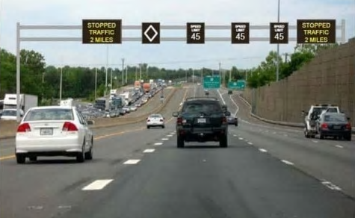
Origin of HSR
Active Traffic Management
Dynamic Speed Limits
Adaptive Ramp Metering
Dynamic Lane Assignments
Queue Warning
Dynamic Rerouting
Adaptive Traffic Signal Control
Dynamic Lane Use/Shoulder Control

Slide 7
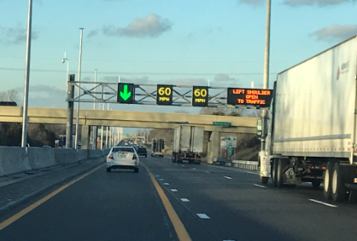
Different HSR Concepts
Left vs. Right
Dynamic vs. Static
Vehicle-Use Options
All vehicles
Transit only
Prohibit trucks
HOV/HOT
Speed Control Options
Same speed (as posted)
Reduced speed

Slide 8
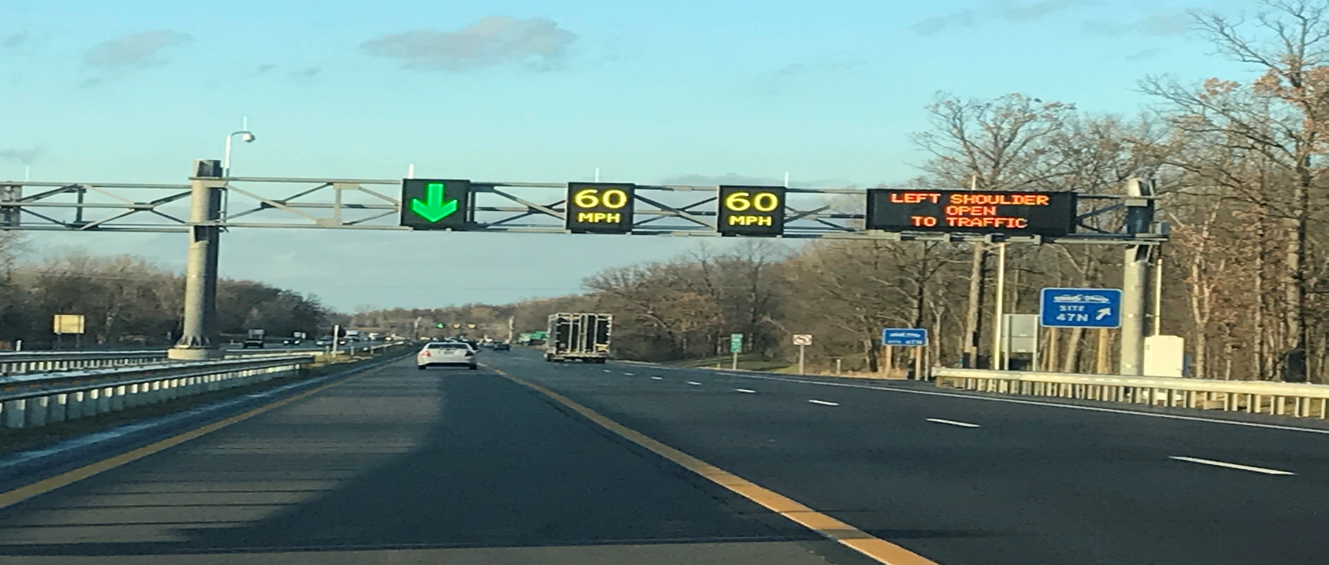
Where is HSR Implemented?

Slide 9
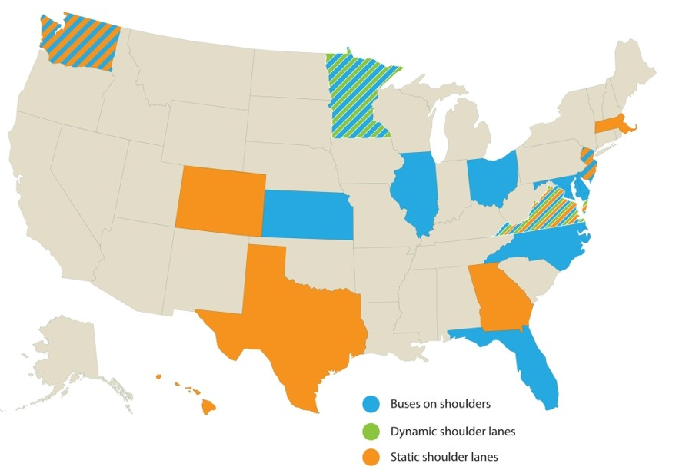
Where is HSR Implemented?
States employing Part-Time Shoulder Use in 2016
Source: FHWA

Slide 10
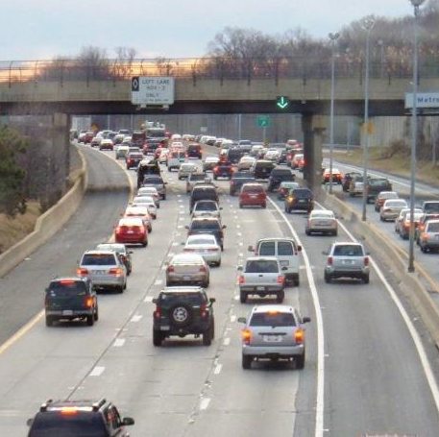
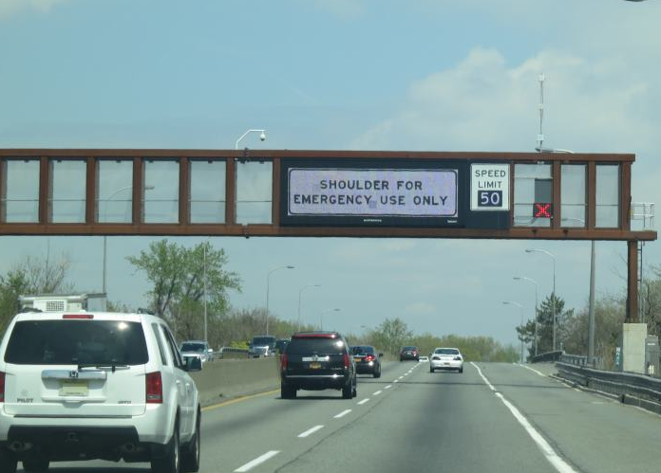
Where is HSR Implemented?
I-66 in Northern Virginia – Dynamic; Right Side
NJ Turnpike – Static; Right Side

Slide 11
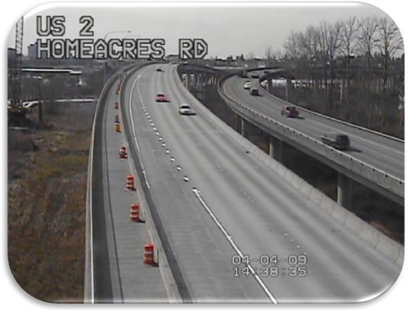
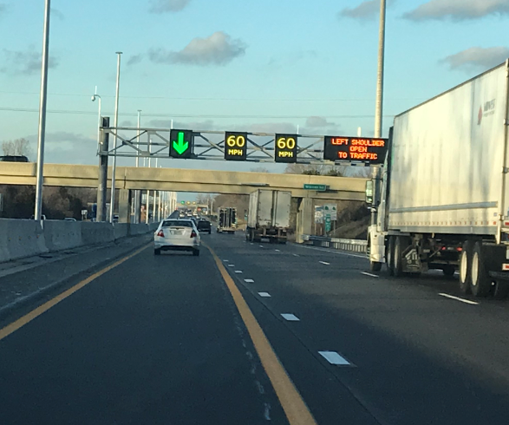
Where is HSR Implemented?
US 2 in Everett, Washington – Static; Right Side
US 23 in Ann Arbor, Michigan – Dynamic; Left Side

Slide 12
Analysis Considerations

Slide 13
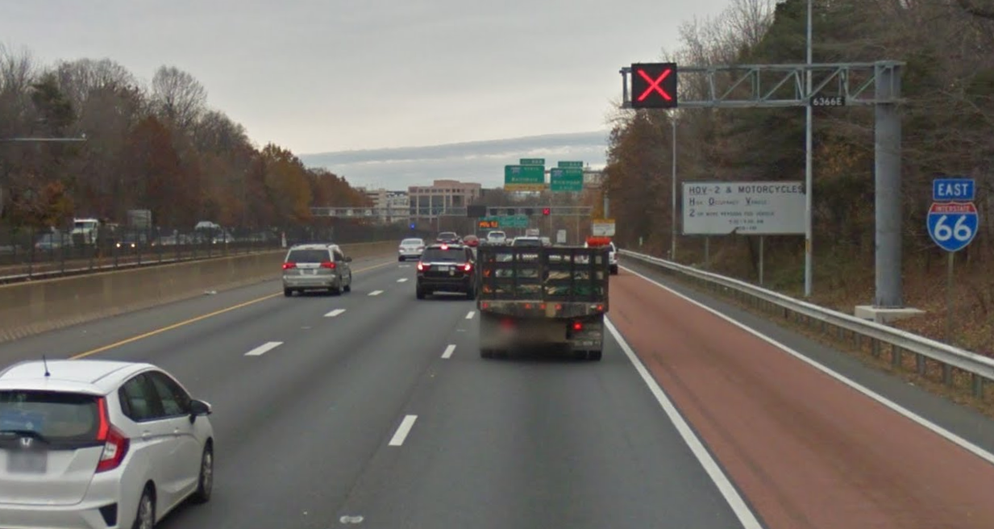
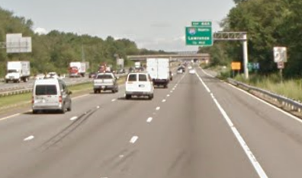
Traffic Analysis
Increased Capacity
Shoulder capacity ranges between 1,000 and 1,650 vehicles per hour
Dependent on geometric conditions and level of communication to the driver
Left shoulder capacity is slightly higher than the right shoulder

Slide 14
Traffic Analysis
HSR Lane Capacity Lower than Freeway Lanes
Highway Capacity Manual (HCM) Analysis
Cannot adjust capacity on per-lane basis
Determine new capacity value for the freeway segment
Microsimulation (VISSIM, TransModeler) Analysis
Can assign capacity and speed on a per-lane basis
Can prohibit different vehicle classes in HSR lane
Great tool for public meeting
Recommendation: Use HCM for preliminary analysis and microsimulation for final alternative

Slide 15
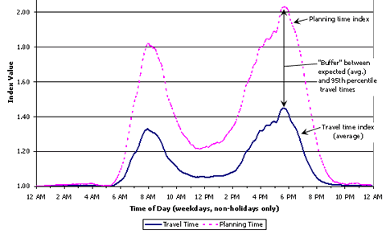
Traffic Analysis
Increased Reliability
Travel times are more consistent on a daily basis
Less buffer time required to ensure on-time arrival
More predictable for users

Slide 16
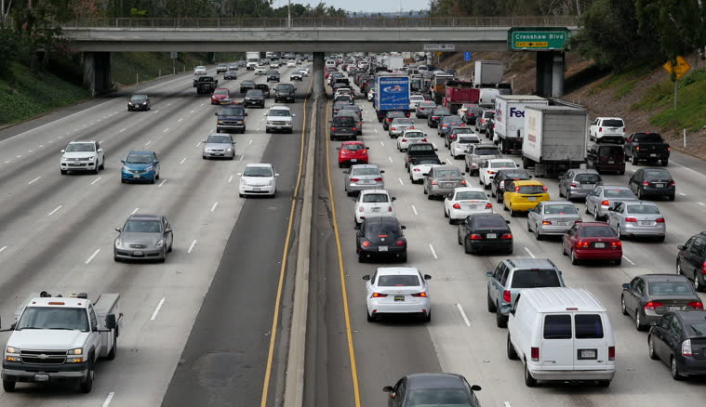
Appropriate Length of HSR
Typically Used on Long Segments That Include Multiple Interchanges
Commuter corridors with recurring congestion
Used to avoid expensive widening over long corridors
Can Be Used on Acute Bottlenecks
Georgia and Hawaii use as auxiliary lanes between interchanges
Termination method is critical to avoid queues

Slide 17
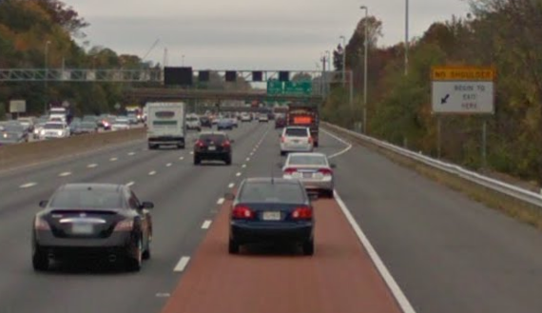
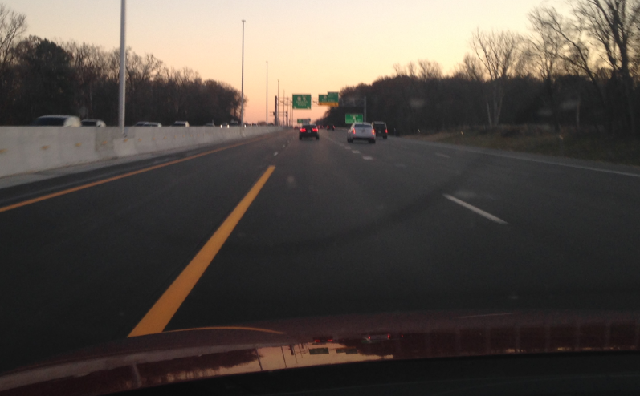
HSR Lane Termination
End on Basic Freeway Segment as a Lane Drop
HSR lane merges into adjacent travel lane; ideally at a location where number of mainline lanes are adequate for traffic volume
Potential to cause queues at merge point
End by Dropping HSR Lane to Interchange Ramp
HSR lane terminates into an exit-only lane at the interchange
Ideally a high-volume exit ramp
Creates a smooth transition of the HSR

Slide 18
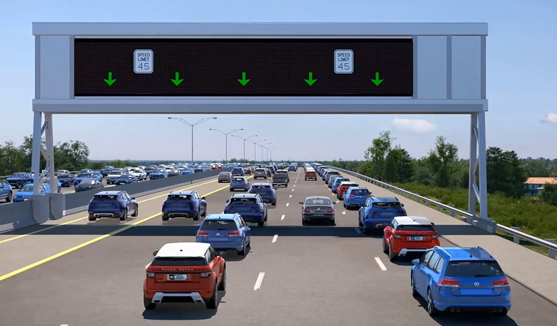
Safety Analysis
How do you predict how HSR will affect safety?

Slide 19
Safety Analysis – Case Study in Ohio
Ohio’s HSR Project
Left Side
Static Operation (4-6pm)
Variable Speed Limit (45mph)
Existing Left Shoulder (14-16 ft)
HSR Lane Width (11.5 ft)

Slide 20
Safety Analysis – Case Study in Ohio
Initial HSM Analysis Results
 | KA | B | C | O | Total
No Build | 6.5 | 22.0 | 23.2 | 137.1 | 188.9
Build | 7.1 | 23.1 | 24.3 | 142.0 | 196.5
Difference | +0.6 (8%) | +1.1 (5%) | +1.1 (5%) | +4.9 (4%) | +7.6 (4%)
DON’T PHOTOGRAPH THIS!
K – Fatal; A – Incapacitating Injury; B – Nonincapacitating Injury; C – Possible Injury; O – Property Damage Only

Slide 21
Safety Analysis – Case Study in Ohio
Holes in HSM Analysis
HSM assumes 24-hour analysis
HSR is only operational for a few hours per day
HSM does not account for speed
HSR is only operational when speeds are lower than free-flow speeds (congestion)
Notes:
Analyzing a shoulder in use for part of the day would require knowledge of the hours of operation and the percent of AADT during those hours. Models would be run twice, and a weighted average could be computed

Slide 22
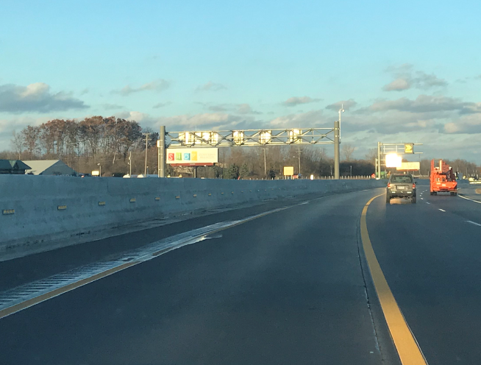
Safety Analysis – Case Study in Ohio
Countermeasures to prevent fixed object crashes
Rumble Strips
Wider Edge Lines
Median Barrier Reflectors
WIDER EDGE LINE
RUMBLE STRIPS

Slide 23
Safety Analysis – Case Study in Ohio
Final HSM Analysis Results (with countermeasures)
 | KA | B | C | O | Total
No Build | 6.5 | 22.0 | 23.2 | 137.1 | 188.9
Build | 5.7 | 18.5 | 19.5 | 142.0 | 185.7
Difference | -0.8 (13%) | -3.5 (16%) | -3.7 (16%) | +4.9 (4%) | -3.2 (2%)
K – Fatal; A – Incapacitating Injury; B – Nonincapacitating Injury; C – Possible Injury; O – Property Damage Only

Slide 24
Safety Analysis – Case Study in Ohio
What do other studies say?
HSR Would Likely Reduce Congestion-Related Crashes
Rear-End
HSR May Increase Crashes Related to Erratic Driver Behavior or Sub-Optimal Geometry
Fixed Object
Run-Off-Road
Sideswipes
Corridors with High Percentage of these Crash Types May Not be Good Candidates for HSR

Slide 25
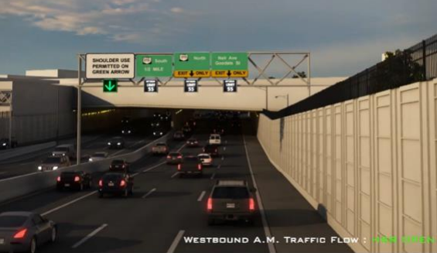
Safety Analysis
Summary of Safety Analysis
HSM Analysis is good, but not perfect
Additional countermeasures may be necessary
Review corridor crash patterns before implementation
Audits have shown safety performance of facilities with HSR is comparable or better

Slide 26
Cost Considerations

Slide 27
Cost Considerations of HSR
Compare to Traditional Improvements
Often less upfront capital cost by often as much as 50%!
Re-use existing infrastructure saves $$
Full-Depth Existing Shoulders
Existing Fiber Backbone
Existing Freeway Management System

Slide 28
However………
HSR typically incur a greater proportion of costs as continuing operations and maintenance
ITS infrastructure often has a much shorter anticipated useful life than traditional improvements
Could result in future funding gaps or the inability to properly operate and maintain system

Slide 29
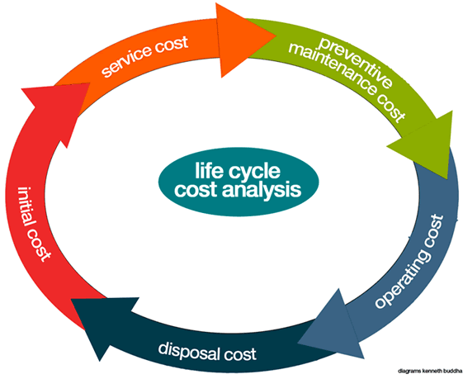
Benefit/Cost Analysis of HSR
Include the following for Costs:
Capital Cost – upfront cost of project improvement
Operations & Maintenance Cost – continuing cost necessary to operate and maintain, including labor costs for activities such as emergency patrols & TMC staff
Replacement Cost – periodic cost of replacing or redeploying equipment as it becomes obsolete and reaches an end of its expected useful life

Slide 30
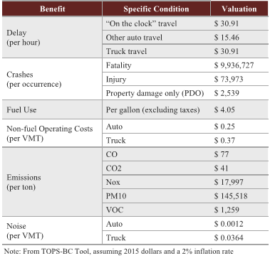
Benefit/Cost Analysis of HSR
Typical Benefits:
Reduced Travel Times
Reduced Delay
Reduced Fuel Consumption
Reduced Number of Crashes
To Monetize Benefits, FHWA TOPS-BC tool is a good source
Spreadsheet-based tool
HSR is one of the strategies – identified as ATDM Hard Shoulder Running

Slide 31
Design Considerations

Slide 32
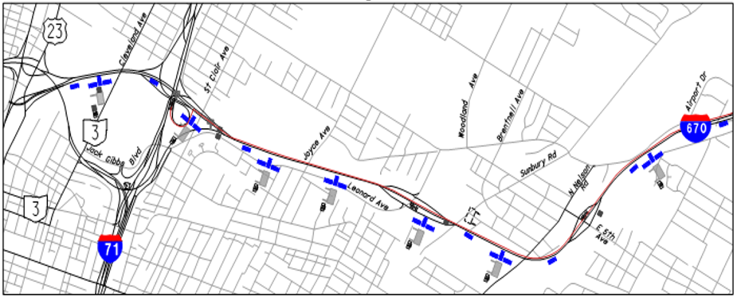
ITS Design – CCTV Cameras
No Blindspots
Number of cameras depends on horizontal geometry (curves), vertical geometry, bridge overpasses, overhead signs

Slide 33
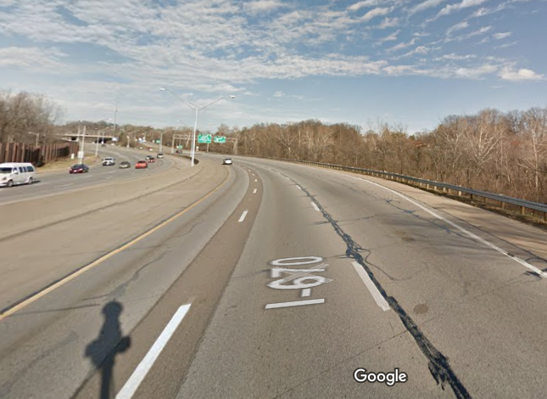
ITS Design - Gantries
Spacing Varies Between ½ and 1 Mile
Function of existing overhead guide sign locations and overhead bridge crossings
Number of ramps
Spacing Depends on their Function
Speed Harmonization
Incident Management
Dynamic Operation
Recommendation: Walk the corridor early in the project and identify preliminary locations of gantries

Slide 34
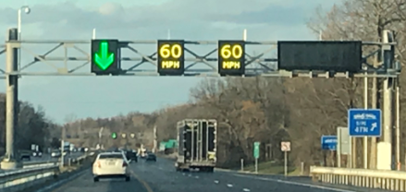
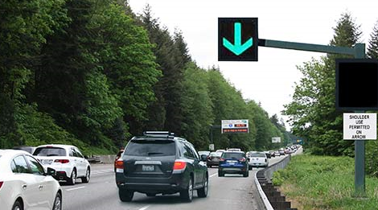
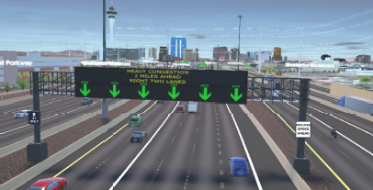
ITS Design – Dynamic Message Signs
Several Options
Individual Bricks
Full-Width Signs
Mounting Options
Truss
Cantilever
Notes:
Often this comes down to a choice of maintenance options – catwalk vs accessing from a bucket truck from the highway. Comes down to whether to close a lane on the highway or not.

Slide 35
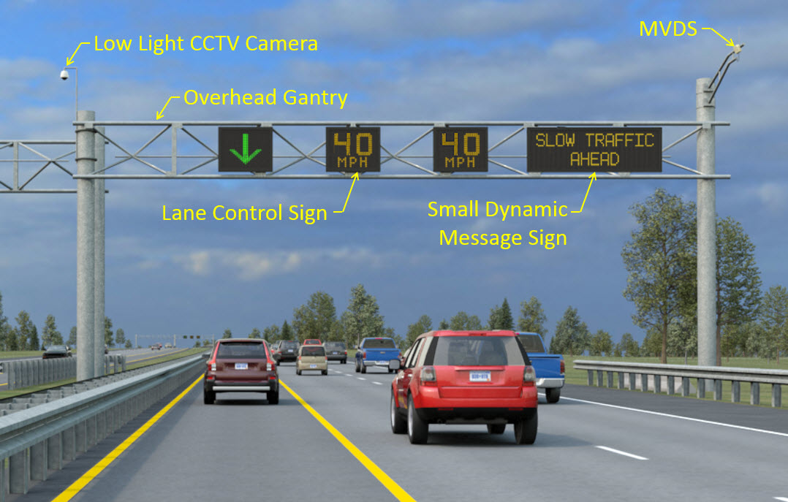
ITS Design – Put It All Together
Notes:
Often this comes down to a choice of maintenance options – catwalk vs accessing from a bucket truck from the highway. Comes down to whether to close a lane on the highway or not.

Slide 36
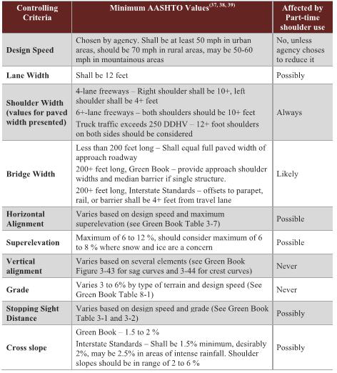
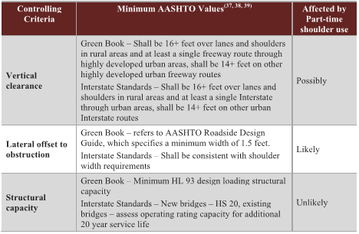
Geometric Design
Key Criteria for HSR:
Lane Width
Shoulder Width/Lateral Offset to Obstruction
Cross Slope/Crown Line Location
Vertical Clearance
Posted Speed

Slide 37
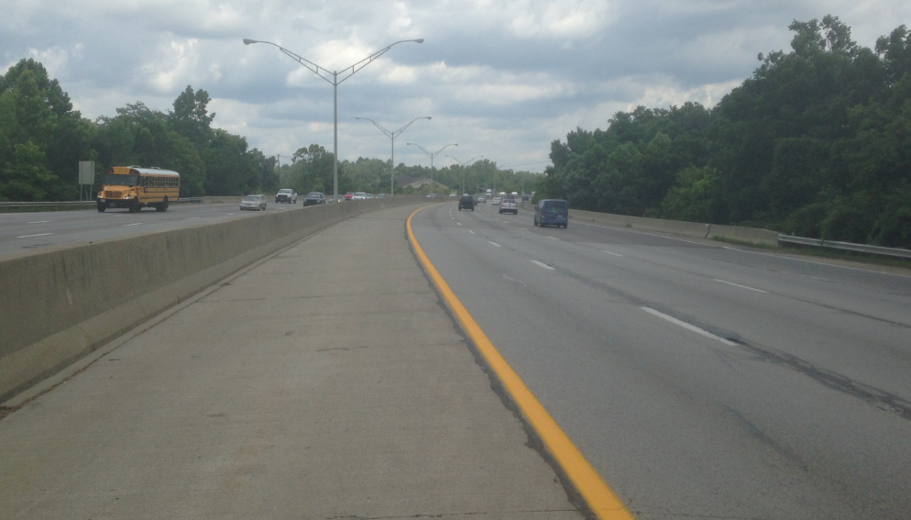
Geometric Design – Cross Slope
Notes:
What do you do on the high-side of superelevation, especially when it crosses over a bridge? Do you rebuild the existing shoulder to introduce some cross slope in the proper direction for the horizontal curve, which would require partial redecking of the existing bridge, or do you allow a variance for cross slope and potentially introduce a safety issue?

Slide 38
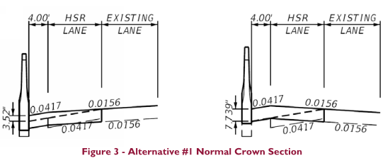
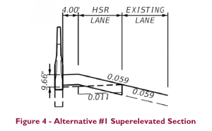
Geometric Design – Cross Slope
Notes:
What do you do on the high-side of superelevation, especially when it crosses over a bridge? Do you rebuild the existing shoulder to introduce some cross slope in the proper direction for the horizontal curve, which would require partial redecking of the existing bridge, or do you allow a variance for cross slope and potentially introduce a safety issue? What about the existing median barrier? Does that need to be replaced as well? And we have now pinched the vertical clearance by 10” in the shoulder lane in the superelevation section. Is that a problem?

Slide 39
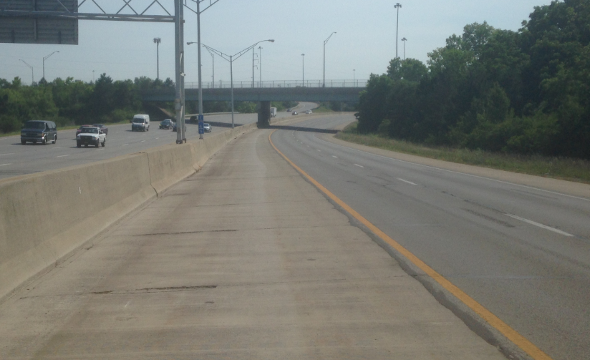
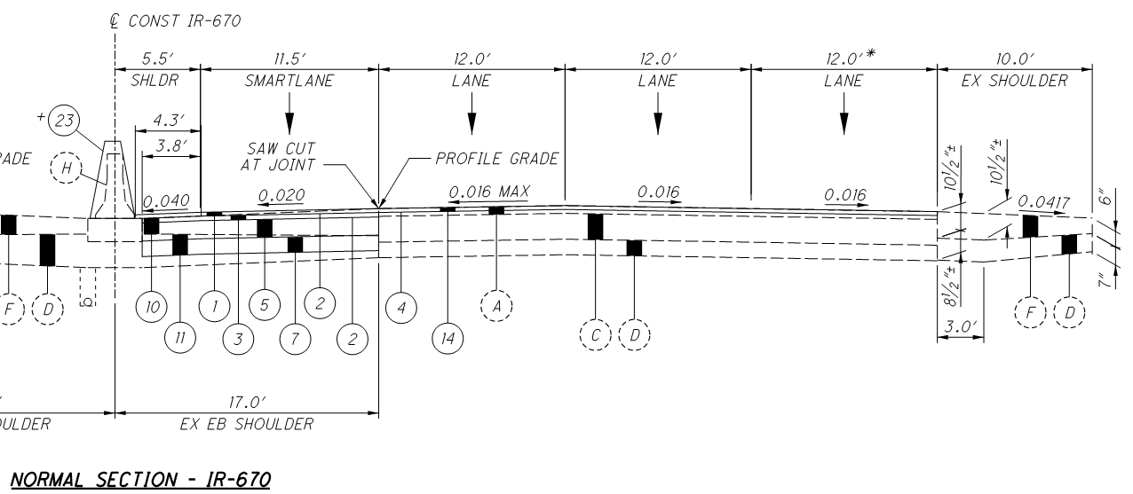
Pavement Design
Existing Shoulder Pavement Depth
Concrete vs. Asphalt
Construction Methods
Joints
Vehicle Usage in HSR
Limit Trucks

Slide 40
Implementation

Slide 41
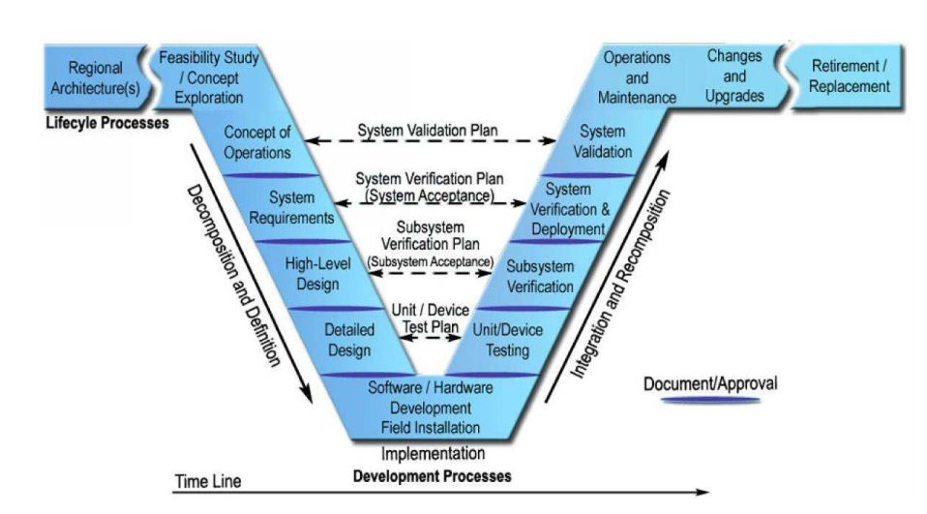
ConOps & Systems Engineering Analysis

Slide 42
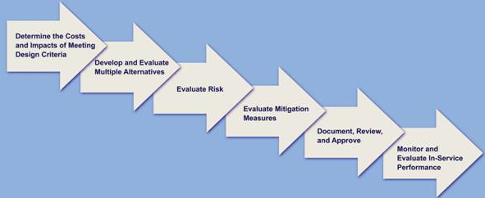
Design Exceptions
Needed if Minimum Controlling Criteria is not met
Explain why it is infeasible to meet Controlling Criteria
Identify Mitigation Strategies
Reduced Speeds
Increased Patrol
Prohibit Trucks
Emergency Pull-Offs
Rumble Strips
Wider Pavement Markings
Barrier Reflectors
Engage FHWA Early and Often!

Slide 43
Stakeholder Engagement
Wide Range of Stakeholders
Planning, Operations, Design, Maintenance staff with DOT
Law Enforcement
Emergency Responders
Transit Agency
MPO Staff
Local Agency
FHWA Division Office
Education and Outreach
Workshops
Peer Exchanges
Notes:
Get the right players at the table; discuss emergency response and incident management concerns; discuss maintenance concerns; discuss transit operation concerns (if applicable)

Slide 44
Public Involvement
General Reaction
Unfamiliarity with the concept
What are the Details (is the shoulder open/closed, how do I know when to get in, is speed limit changing, what if I break down?, etc.)
Workshops, Forums, Local Council Meetings
Commuter traffic
Various Media Campaigns
Notes:
Depending on the site however, may be a lot of commuter traffic – getting them to public meetings may be difficult

Slide 45
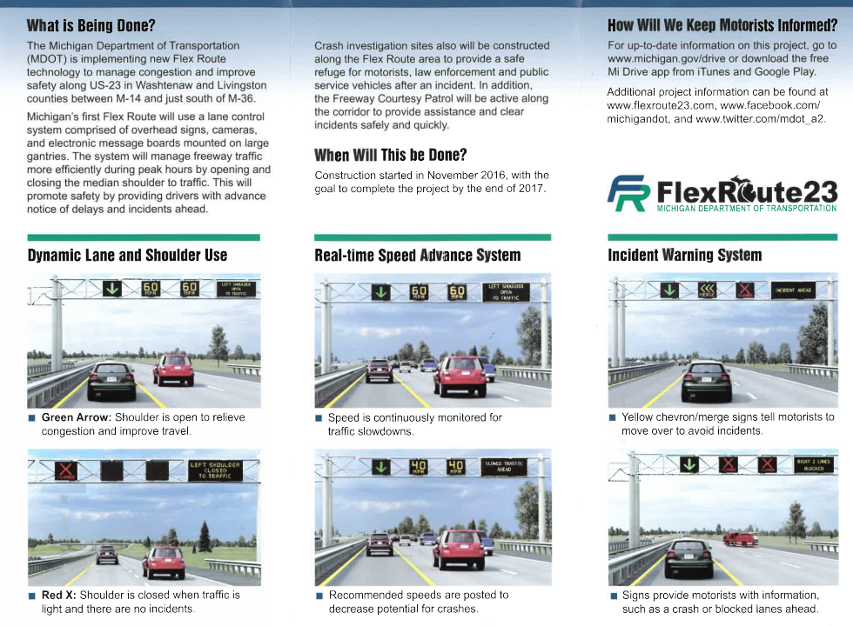
Public Outreach
Michigan DOT

Slide 46
Operations

Slide 47
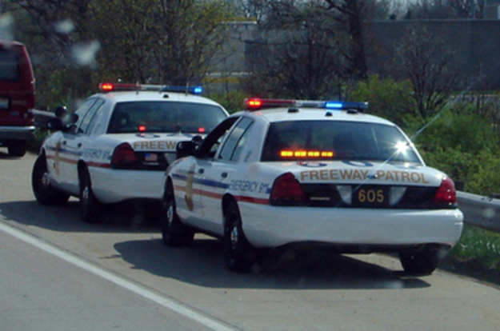
Law Enforcement
Enforcement of improper lane usage and speed violators challenging
Congestion
Where to pull over violators
Maintaining a shoulder to pull off is critical
During plan development, have Law Enforcement tour the TMC
Engage Early!

Slide 48
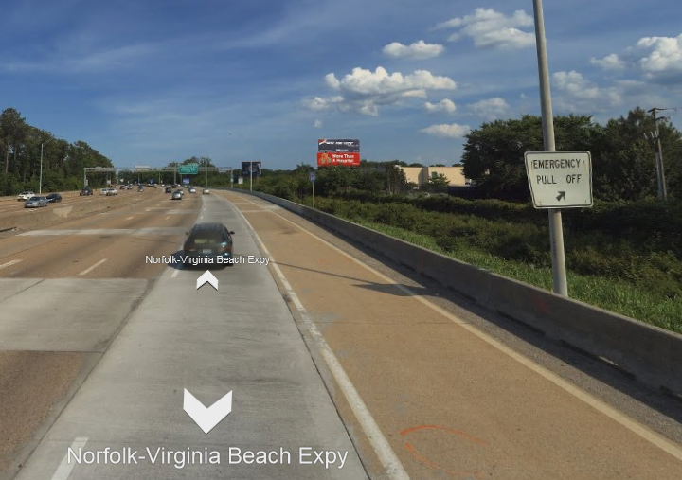
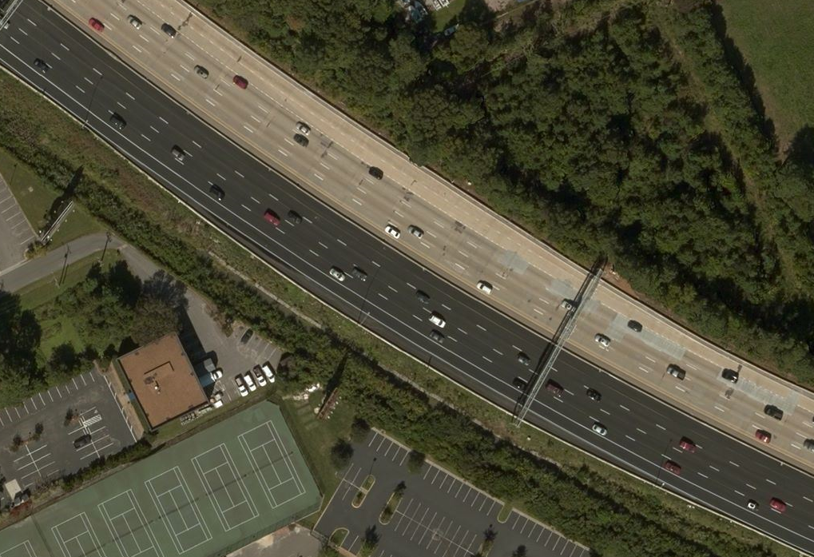
Emergency Pull-Offs - Virginia

Slide 49
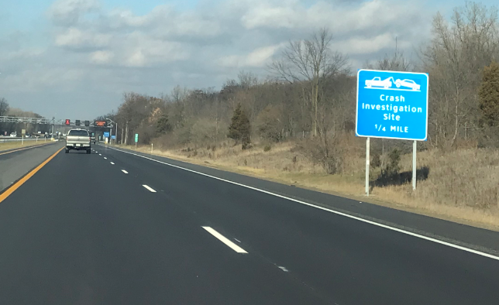
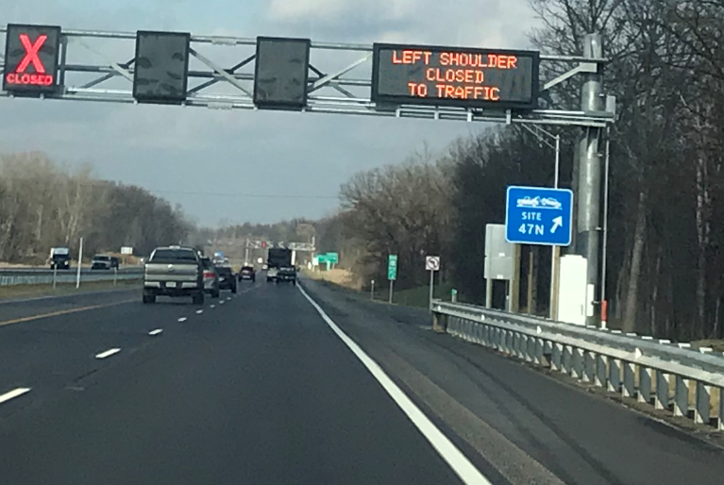
Emergency Pull-Offs - Michigan
Notes:
Michigan identifies all of their shoulder pull-off areas (this one identified as 47N) for quicker response time. Notice that Michigan has a left-shoulder HSR lane but uses their pull-offs on the right side where there is already a “wide” shoulder. This was done as mitigation for their Design Exception. Not always practical………

Slide 50
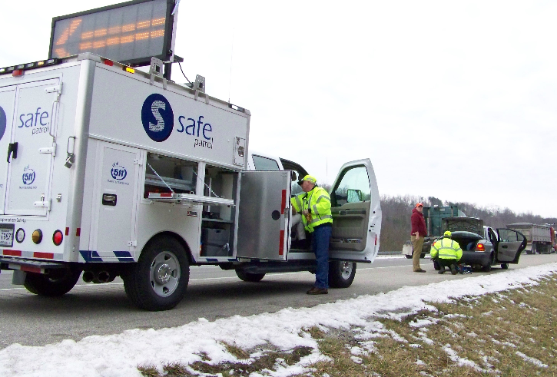
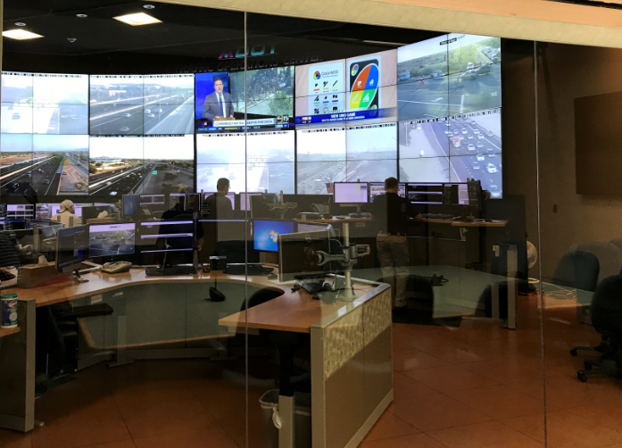
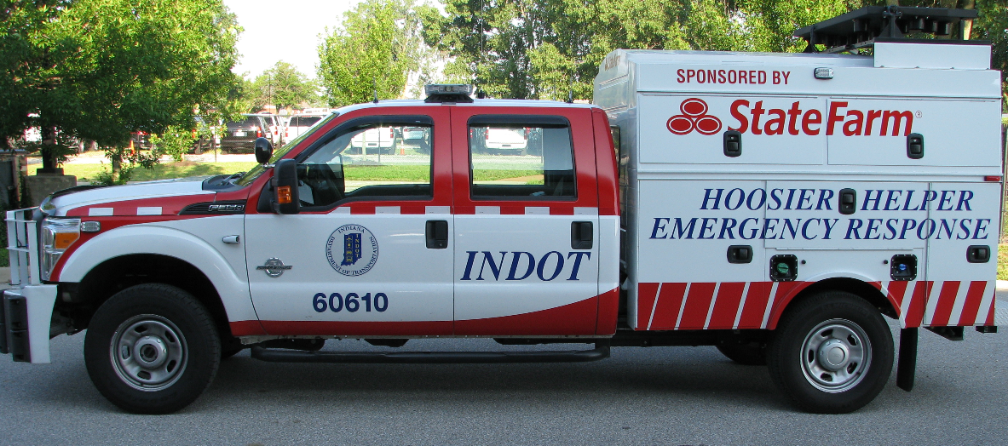
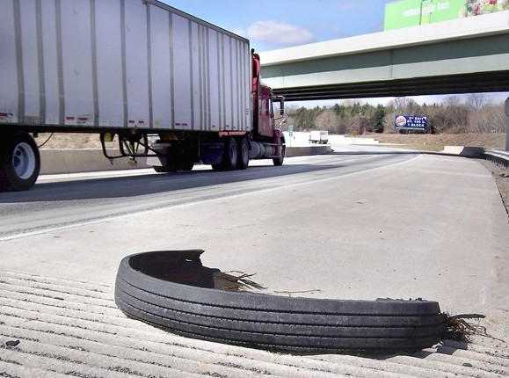
System Start-Up – Daily Sweep

Slide 51
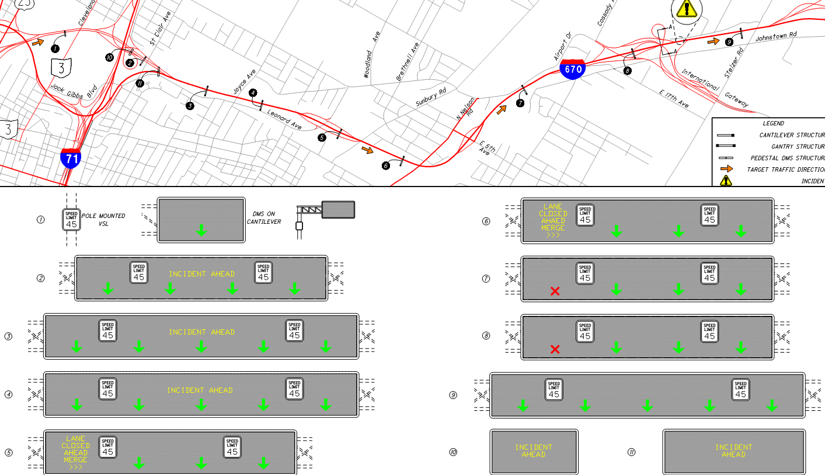
Incident Management
Notes:
If the incident occurs at the end of the SmartLANE corridor, advanced signing warning drivers of an incident and indicating that the lane will be closing can be given using the 9 overhead gantry signs and 1 cantilever sign at the beginning of the project.

Slide 52
Screening Process

Slide 53
Screening Process - Planning
Is HSR consistent with region’s long-range plan?
What is the transportation need in the corridor?
Does the region have experience with TSM&O strategies?
Is HSR feasible from a constructability standpoint?
Is real-time monitoring and incident response in place?
What are the impacts?
Does HSR implementation reduce cost compared to traditional projects?
How can HSR be designed and operated to optimize benefits and mitigate impacts?

Slide 54
Screening Process – Pre-Engineering
Does the paved shoulder width meet minimum widths for carrying traffic?
If not, lower speeds or prohibit trucks?
Do bridges over the shoulder meet minimum clearance height requirements?
If not, special vehicle-height restrictions necessary?
Is the shoulder pavement depth sufficient for carrying traffic?
If not, prohibit trucks/heavy vehicles?
Is the drainage system compatible with shoulder use?
If not, modify drainage or lower speeds?

Slide 55
Screening Process – Pre-Engineering
Do the bridges along the corridor provide enough lateral width for shoulder use?
If not, is widening an option?
Is the length of the HSR segment long enough to provide meaningful congestion relief?
If not, is the segment addressing an acute bottleneck?
Can safety concerns be resolved?
Can ramp merge visibility and merging distance issues be resolved?
Can substandard geometry be mitigated through lower speeds, vehicle restrictions, or ATM?
Can the concerns of emergency first-responders and maintenance personnel be resolved?

Slide 56
Potentially Good HSR Candidates
Reliable and repeatable periods of congestion
Lateral width to accommodate HSR implementation
Minimal widening of bridges along the corridor
Minimal corrections to overhead bridges in order to fit the HSR cross section under
Prefer a long corridor for HSR implementation
Prefer full-depth existing shoulders
Prefer ITS-compatible corridor
Prefer tangential alignments or horizontal curves where HSR is on the outside
Prefer to minimize R/W impacts

Slide 57
Questions?
Contact:
Brian Toombs, PE
Burgess & Niple, Inc.
614.459.2050 (o)
614.946.9343 (c)
Brian.toombs@burgessniple.com

Slide 58
Extra Slides

Slide 59
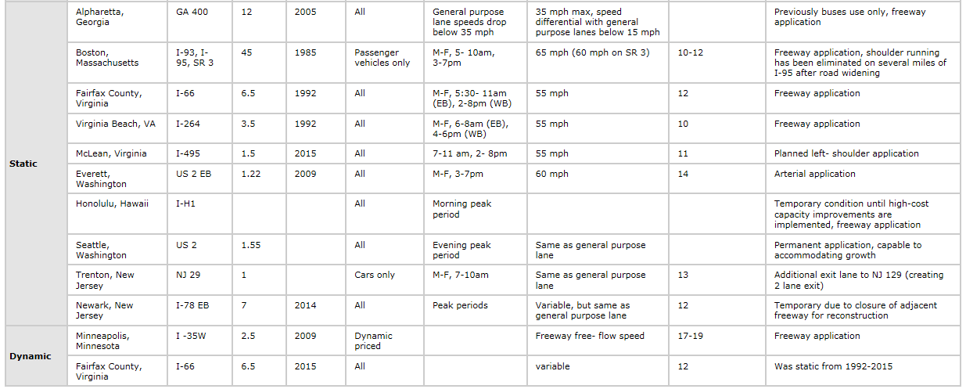
Where is HSR Implemented?
Source: FHWA (Use of Freeway Shoulders for Travel)

Slide 60
Where is HSR Implemented?
I-95 in Boston, Massachusetts – Static; Right Side
Notes:
Site in Boston limits the shoulder use to just cars. They are also in the process of widening I-95 to accommodate a permanent lane so they are slowly phasing out the HSR implementation here

Slide 61
HSR Lane Termination
Existing Lane
New Perm. Lane
HSR/Ex. Shoulder

Slide 62
Safety Analysis – Case Study in Ohio
Crashes along EB I-670 between 2014 and 2016 (282 Total Crashes)
67 Crashes
138 Crashes
77 Crashes
40 Crashes

Slide 63
Public Outreach
Washington DOT
Virginia DOT

Slide 64
Incident Management
Notes:
Incident Management

Slide 65
Incident Management
Notes:
Multi-Purpose DMS to improve communication to drivers

Slide 66
Incident Management - Ohio
Notes:
If the incident occurs near the beginning of the SmartLANE corridor, advanced signing warning drivers of an incident and indicating that the lane will be closing can be given; once the driver is past the incident, notice that the lane is back open to drivers.

Slide 67
Incident Management - Ohio
Notes:
These overhead gantries are also beneficial during off-peak (when the SmartLANE isn’t open). They can be used to warn drivers of temporary lane closures along the corridor; again notice that once past the incident, the lane(s) are open to traffic again. NOTE: the yellow merge arrows are not yet approved for use by FHWA (not in the MUTCD) but the team is working on that. If they aren’t approved for this project, a yellow “X” would be used instead.
All of this requires extensive system programming and training for the personnel

Slide 68
Other State’s Lessons Learned

Slide 69
Lessons Learned - Michigan
Keep It Simple
Software can be complicated; simplify the number of strategies
External controller for the DMS allows easier maintenance and smaller/cheaper signs
Budget Actual Costs of Project
Include maintenance costs when determining budget
Include training budget for TMC personnel
Engage FHWA
Coordinate with FHWA early in the project

Slide 70
Lessons Learned - Virginia
Work Closely with FHWA
Design Exception Process
Systems Engineering Analysis (SEA)
Conceptual Operations (ConOps)
Better Public Engagement
VDOT completed Public Involvement in-house
Utilize staff that communicate well to ALL users, not just engineers; reach all users through technology
Emergency Responders
Engage during design to ensure they are accommodated

Slide 71
Lessons Learned - Minnesota
Engaged FHWA early
Design Exception process went smoothly
Multiple Strategies for Operations
Several for inclement weather
Several for various incidents
Several for various levels of congestion
Became challenging getting operators trained
Public Involvement
Completed this in-house
Struggled to get education out to all users prior to opening

Slide 72
Lessons Learned - Washington
FHWA Engagement
Didn’t engage them early enough in the project process
Documentation
Filed several design variances
Needed good documentation of the variances
Needed good justifications for the variances
Public Involvement
Completed this in-house
Struggled to get education out to all users prior to opening

